Slide 1
Team scoring Highest scoring week: Peanuts, week 8, 183 Lowest scoring week: The GOAT, week 8, 59.1 Closest win: Week 2—The GOAT vs. Sasquatch (Sasquatch by 0.82) Biggest blowout: Week 8-Peanuts vs. First Timers (Peanuts by 95.3)

Slide 2
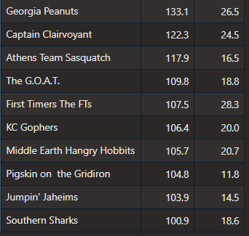
Team scoring: Most average points & most variation

Slide 3
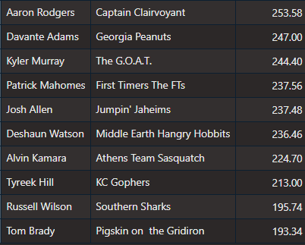
MVPs: Top scorers for each team (from week 3)

Slide 4
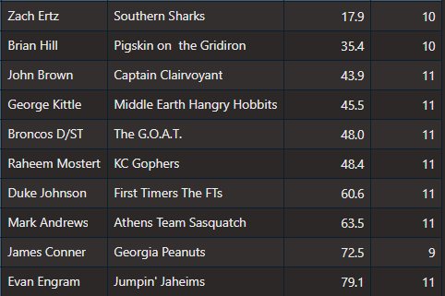
LVPs: Bottom scorers for each team (min 8 weeks)

Slide 5
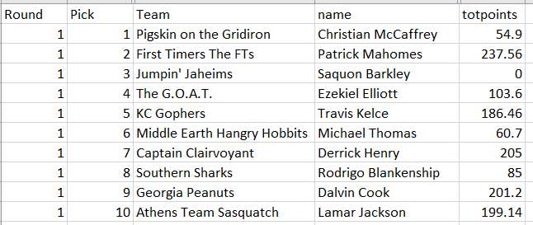
Draft recap: Round 1

Slide 6
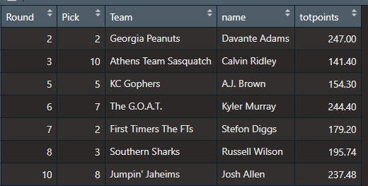
Draft recap: Who won rounds 2-10?

Slide 7
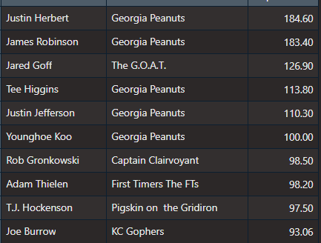
Draft recap: Top undrafted

Slide 8
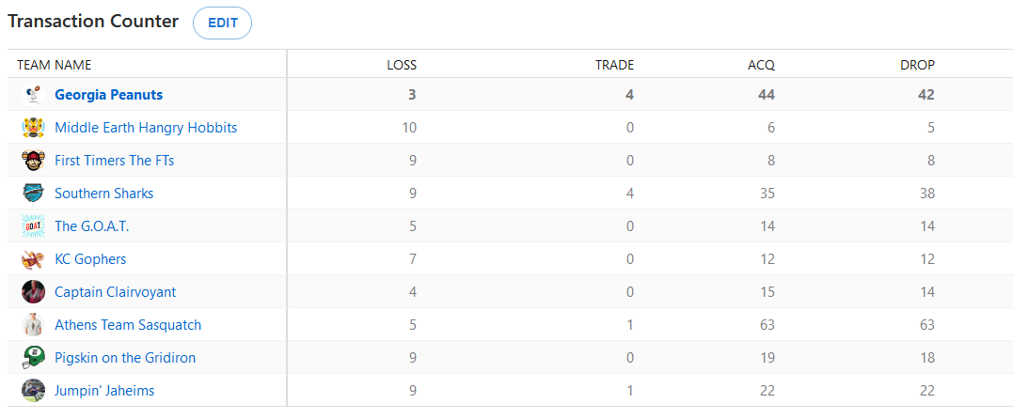
Transaction counter

